Slide 1

DATA ANALYTICS PROCESS DATA SCIENCE -18CS3211 Session no: 05

Slide 2

AGENDA FOR THIS CLASS
Describe Data Analytics process and its steps
List the skills and tools required for data analysis
Understand the challenges of the Data Analytics process
Explain Exploratory data analysis technique

Slide 3
Why Data Analytics
Data by itself is just an information source. But, unless you understand it, you will not be able to use it effectively.
Students_ID | Score_Internal | Score_External
10001 | 45 | 35
10002 | 47 | 39
10003 | 48 | 42
10004 | 43 | 34
10005 | 36 | 30
10006 | 39 | 34
10007 | 43 | 46
10008 | 45 | 23
10009 | 42 | 25

Slide 4
Data Science
Students’ ID | Score_Internal | Score_External
10001 | 45 | 35
10002 | 47 | 39
10003 | 48 | 42
10004 | 43 | 34
10005 | 36 | 30
10006 | 39 | 34
10007 | 43 | 46
10008 | 45 | 23
10009 | 42 | 25
When the details are presented as a line chart, the internal score and external score become apparent.

Slide 5

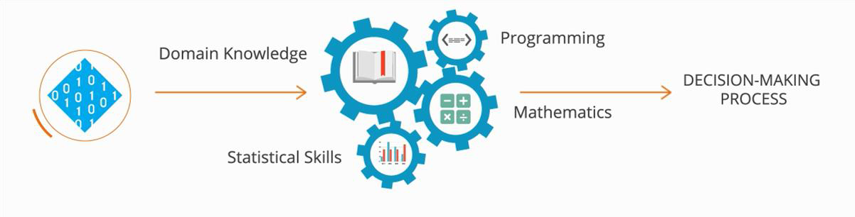
Introduction to Data Analytics
Data Analytics is a combination of processes to extract information from datasets.

Slide 6
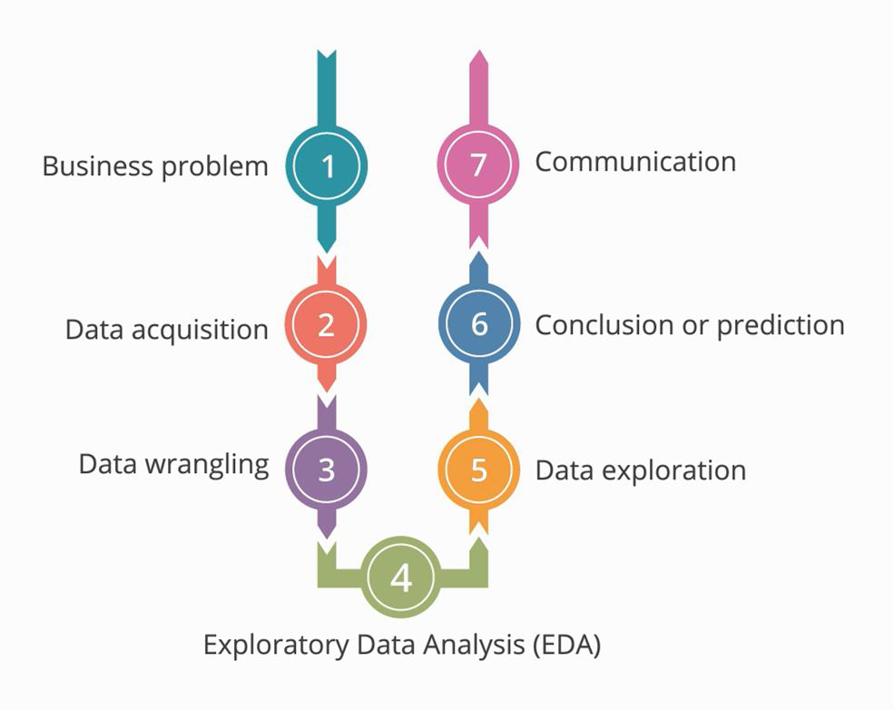
Data Analytics Process

Slide 7
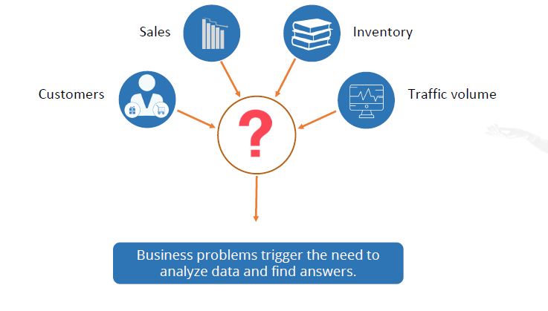
1. Business Problem
The process of analytics begins with questions or business problems of stakeholders.

Slide 8

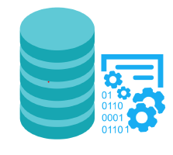
2. Data Acquisition
Twitter, Facebook, LinkedIn, and other social media and information sites provide streaming APIs.
Data Scientist Expertise:
•File handling
•File formats
•Web scraping
Server logs can be extracted from enterprise system servers to analyze and optimize application performance

Slide 9
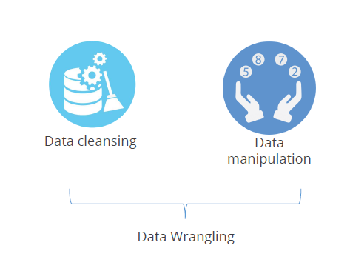
3. Data Wrangling
Data wrangling is the most important phase of the data analytic process.

Slide 10
Data Wrangling: Challenges
This phase includes data cleansing, data manipulation, data aggregation, data split, and reshaping of data.
Causes of challenges in the data wrangling phase:
Unexpected data format
Erroneous data
Voluminous data to be manipulated
Classifying data into linear or clustered
Determining relationship between observation, feature, and response
Data wrangling is the most challenging phase and takes up 70% of the Data Scientist’s time.

Slide 11
4. Exploratory Data Analysis (EDA)
EDA approach studies the data to recommend suitable models that best fit the data.
The focus is on data; its structure, outliers, and models suggested by the data.
EDA techniques make minimal or no assumptions. They present and show all the underlying data without any data loss.
Quantitative: Provides numeric outputs for the inputted data Graphical: Uses statistical functions for graphical output

Slide 12
The significance of EDA
To be certain of the insights that the collected data provides and to make further decisions, data mining is performed where we go through distinctive analysis processes.
Exploratory data analysis is key, and usually the first exercise in data mining.
It allows us to visualize data to understand it as well as to create hypotheses for further analysis.
The exploratory analysis centers around creating a synopsis of data or insights for the next steps in a data mining project.
EDA reveals ground truth about the content without making any underlying assumptions.

Slide 13
Steps in EDA
Problem definition:
Before trying to extract useful insight from the data, it is essential to define the business problem to be solved.
Data preparation:
This step involves methods for preparing the dataset before actual analysis.
Data analysis:
This is one of the most crucial steps that deals with descriptive statistics and analysis of the data.
Development and representation of the results:
This step involves presenting the dataset to the target audience in the form of graphs, summary tables, maps, and diagrams.

Slide 14
EDA: Making sense of data
It is crucial to identify the type of data under analysis. In this section, we are going to learn about different types of data that you can encounter during analysis.
Numerical data (e,g., age, height, weight etc. )
Discrete data (e,g., values of country can be: India, Japan etc)
Continuous data (e.g., body temperature, height etc)
Categorical data ( gender, Category etc. )

Slide 15
EDA: Measurement scales
Nominal:
These are practiced for labeling variables without any quantitative value. The scales are generally referred to as labels. And these scales are mutually exclusive and do not carry any numerical importance.
Ordinal:
In ordinal scales, the order of the values is a significant factor.
Interval:
In interval scales, both the order and exact differences between the values are significant
Ratio:
Ratio scales contain order, exact values, and absolute zero, which makes it possible to be used in descriptive and inferential statistics.

Slide 16
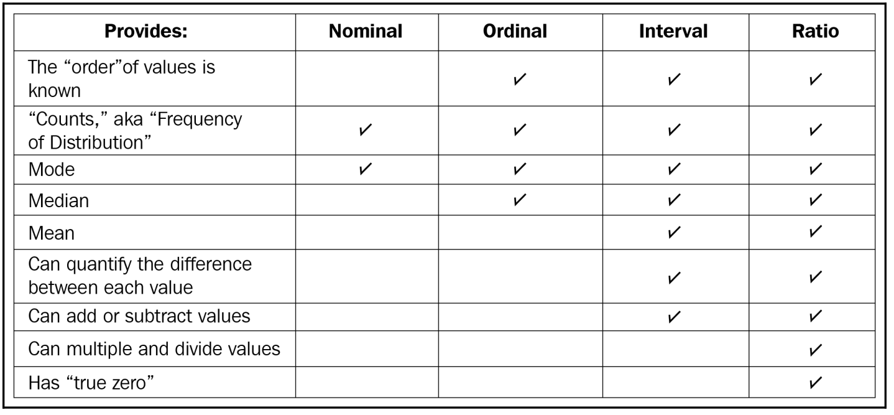
EDA: Measurement scales

Slide 17
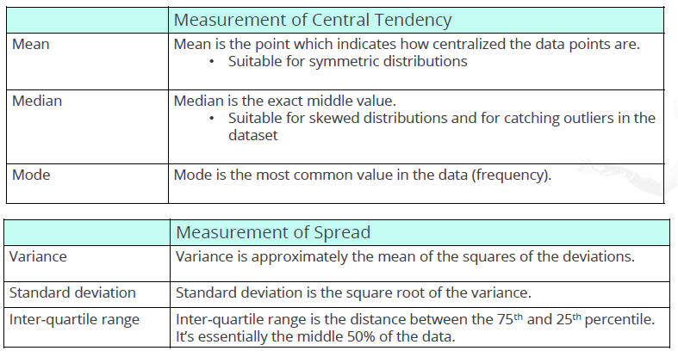
EDA: Quantitative Technique
EDA: Quantitative technique has two goals, measurement of central tendency and spread of data.

Slide 18
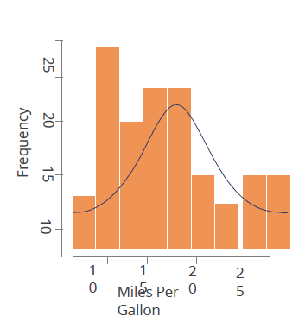
EDA: Graphical Technique
Histogram graphically summarizes the distribution of a univariate dataset.
It shows:
•the center or location of data (mean, median, or mode)
•the spread of data
•the skewness of data
•the presence of outliers
•the presence of multiple modes in the data

Slide 19
5. Data Exploration: Model Selection
Model selection
Based on the overall data analysis process
Should be accurate to avoid iterations
Depends on pattern identification and algorithms
Depends on hypothesis building and testing
Leads to building mathematical statistical functions

Slide 20
6. Conclusion or Prediction
Involves heavy use of mathematical and statistical functions
Requires model selection, training, and testing to help in forecasting
Is called machine learning as data analysis is fully or semi-automated with minimal or no human intervention

Slide 21
6. Conclusion or Prediction
This step involves reaching a conclusion and making predictions based on the data analysis
Involves heavy use of mathematical and statistical functions
Requires model selection, training, and testing to help in forecasting

Slide 22
7. Communication
Forms of Data analysis presentations:
Visual graphs
Plotting maps
Reports
Whitepaper reports
PowerPoint presentations

Slide 23
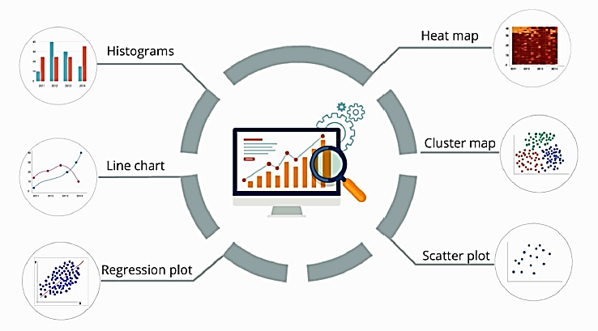
Types of Plot

Slide 24
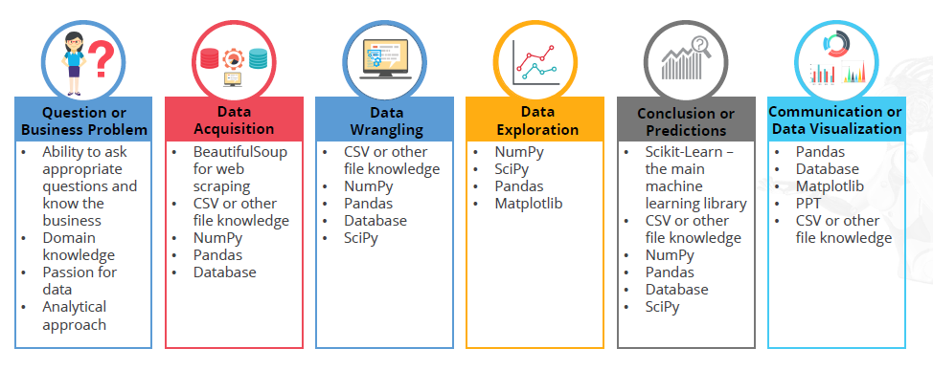
Data Analytics: Skills and Tools

